Slide 1

Incremental Security Enforcement of Cyber Physical Systems
Team P1-07
Aaditya Kumar Muktavarapu HU21CSEN0100580
Karthik Neriyanuri HU21CSEN0100607
Vijay Anirudh Vallabhu HU21CSEN0100611
Lalit Narayanam HU21CSEN0101246
Under the Guidance of Dr Sudeep K.S

Slide 2
Introduction
Cyber-physical systems (CPS) are becoming increasingly prevalent in critical infrastructure, including transportation, healthcare, and energy.
These systems are vulnerable to cyberattacks, posing significant risks to safety, reliability, and security.
Traditional security approaches are often monolithic and static, making them inflexible and unable to adapt to evolving threats.
We propose a novel approach to security enforcement for CPS that is incremental and adaptable, allowing for the continuous integration of new security policies.

Slide 3
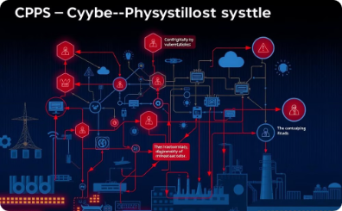
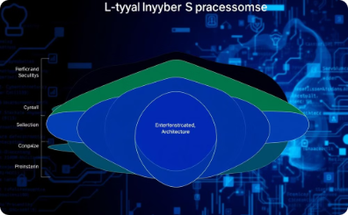
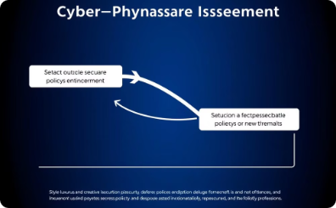

Abstract
Cyber-Physical Systems (CPS)
Incremental Security Enforcement
Runtime Enforcement (RE)
Controlled Environment
Cyber-physical systems (CPS) are becoming increasingly prevalent in critical infrastructure, including transportation, healthcare, and energy.
This capstone project will focus on developing an incremental security enforcement framework for CPS, addressing the increasing threat of cyber-physical attacks (CP-attacks).
The project aims to create a framework that can incrementally add new security policies to CPS as new threats are identified.
The project will showcase how such a framework can be designed, implemented, and tested in a controlled environment.

Slide 4
Literature Review
Incremental Security Enforcement for Cyber-Physical Systems: By ABHINANDAN PANDA, ALEX BAIRD, SRINIVAS PINISETTY, AND PARTHA ROOP.
This paper delves into the concepts of incremental security enforcement, providing the foundation for the project.
Scalable Security Enforcement for Cyber Physical Systems: By ALEX BAIRD, ABHINANDAN PANDA, HAMMOND PEARCE, SRINIVAS PINISETTY, AND PARTHA ROOP.
This paper explores the scalability of security enforcement mechanisms for cyber-physical systems.
Monitoring and Defense of Industrial Cyber-Physical Systems Under Typical Attacks: By Yuchen Jiang, Shimeng Wu, Renjie Ma, Ming Liu, Hao Luo, and Okyay Kaynak.
This paper investigates the challenges of monitoring and defending industrial cyber-physical systems.

Slide 5
Summary
Incremental Security Enforcement for CPS: Addresses the challenges of securing CPS against evolving cyber-physical attacks (CP-attacks).
Novel Compositional Runtime Enforcement (RE) Framework: Enables incremental addition of new security policies as threats evolve.
Scalable and Efficient Security Enforcement: Solves the state space explosion problem of traditional monolithic enforcement methods.
Experimental Validation: Demonstrates the effectiveness of the framework using algorithms for input and output enforcement functions.
Linear Performance Scaling: The compositional RE approach achieves a linear relationship between the number of policies and key performance metrics.

Slide 6

Problem Statement: The Need for Incremental Security Enforcement
1
Evolving Threats
2
Legacy Systems
The security landscape for CPS is constantly evolving, with new attack vectors emerging continuously.
Many CPS are built on legacy systems with outdated security measures, making them vulnerable to modern threats.
3
Dynamic Environments
4
System Complexity
CPS often operate in dynamic environments, where changes in configuration or functionality can introduce new security risks.
The interconnected nature of CPS makes them complex and difficult to secure completely.

Slide 7

Evolving Threat Landscape in CPS
1
Data Breaches
Compromised data can lead to operational disruption, financial loss, and reputational damage.
2
Denial of Service
Attacks can disrupt operations by overloading systems or preventing access to critical resources.
3
Malicious Control
Attackers can gain unauthorized control of system components, potentially leading to physical harm or system failure.

Slide 8
Limitations of Traditional Security Approaches
Static Security
Centralized Control
Limited Scalability
Traditional approaches are often static and inflexible, unable to adapt to evolving threats.
Centralized security management can be inefficient and susceptible to single points of failure.
Traditional methods may struggle to scale effectively in complex and distributed CPS environments.

Slide 9

Tackling State Space Explosion
Traditional security enforcement methods often struggle with the problem of state space explosion. This problem arises from the vast number of possible system states that need to be considered for comprehensive security analysis.
As CPS become more complex, the number of potential states increases exponentially, making it computationally infeasible to analyze and secure all possible scenarios.

Slide 10
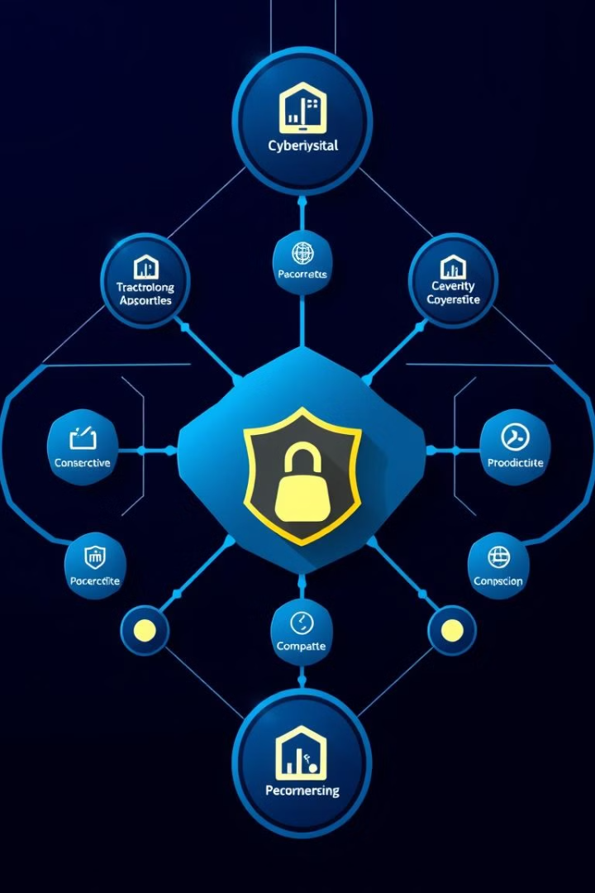
Objectives:
Introducing a Framework for Incremental Security Enforcement
Dynamic Security
Decentralized Control
The framework adapts to changing threats and system configurations.
Security measures can be deployed and managed independently at different system levels.
Scalability
The framework can scale effectively to accommodate complex and distributed systems.

Slide 11




Towards a Resilient and Secure Cyber Physical Ecosystem
Enhanced Security
CPS are better protected from emerging threats and vulnerabilities.
Improved Resilience
The ecosystem can withstand disruptions and recover from attacks.
Sustainable Development
A secure and resilient CPS ecosystem enables innovation and growth.

Slide 12

Data Set: Simulated Cyber Physical System Environment
The project utilizes a simulated environment to evaluate the framework's performance.
The dataset consists of various scenarios and configurations of CPS, such as a drone swarm, where different security policies are enforced incrementally.
These scenarios help test the effectiveness of the proposed solution in a controlled setting.

Slide 13
Tools and Technologies Used
Programming Languages
Runtime Enforcement Framework
The project leverages C and synchronous programming languages for real-time policy enforcement.
A custom runtime enforcement framework, extending easy-rte, provides a flexible platform for security policy enforcement.
Simulation Tools
Custom Compilers
Simulation tools enable testing and evaluation of the framework's effectiveness under various CPS scenarios and configurations.
Custom compilers generate serially composed enforcers for efficient and modular security policy implementation.

Slide 14
Project Flow and Approach
Problem Identification and Literature Review
1
The project identified limitations of existing CPS security mechanisms and reviewed literature on runtime enforcement.
2
Framework Design
A compositional RE framework was designed to incrementally enforce security policies expressed as safety automata.
Implementation of Enforcement Functions
3
The core implementation focused on input/output enforcement and select functions to monitor and modify events, ensuring adherence to security policies.
4
Composition of Enforcers
To avoid state space explosion, serial composition incrementally adds enforcers, layering them for independent security patch application.
Development of the Compositional Enforcement Framework
5
A custom compiler based on easy-rte generates serially composed enforcers for defined security policies, handling various input/output transformations.
6
Testing and Evaluation
The framework was tested in a simulated CPS environment to evaluate its performance as the number of policies increased.
Documentation and Reporting
7
The project documented the framework's architecture, implementation, testing scenarios, and analysis of results, highlighting the advantages of the compositional RE framework.

Slide 15




Runtime Enforcement Techniques for Adaptable Security
Policy Monitoring
Continuous monitoring of system behavior and security policies.
Policy Enforcement
Implementation of security policies at runtime, ensuring compliance.
Policy Adaptation
Dynamic adjustment of security policies based on detected threats and system changes.

Slide 16

Integrating New Security Policies as Threats Emerge
Threat Identification
Detection of new or evolving threats targeting the CPS.
Policy Design
Development of new security policies to mitigate the identified threats.
Policy Deployment
Integration of new security policies into the CPS at runtime.

Slide 17
Existing Methodologies
Monolithic Enforcement
Combines all policies into a single, unified state machine.
Limitations:
State Space Explosion: Each additional policy exponentially increases the total state space.
Re-certification Requirement: Adding new policies requires re-synthesis of the enforcer, making updates cumbersome and inefficient.
Loss of Modularity: Interdependencies between policies make it challenging to isolate or modify individual policies.

Slide 18
Runtime Verification(RV) Techniques
Focus on monitoring system behavior to detect policy compliance without directly altering system actions.
Observation-Based Verification: Monitors observe system events and states for compliance, alerting when violations are detected but without intervening.
Limitations:
No Dynamic Enforcement: Passive monitoring only alerts, rather than corrects, violations, requiring manual intervention.
Inadequate for Reactive CPS: Lacks real-time intervention capability, making it unsuitable for CPS requiring immediate response to threats, such as autonomous vehicles and medical systems.
Applications:
Fault Detection
Anomaly Detection
Policy Compliance Reporting

Slide 19
Synchronous Programming Approaches
Ideal for defining deterministic safety automata in CPS, providing reliable, real-time enforcement of predefined security policies.
Usage:
Deterministic Safety Automata:
Predictable Behavior:
Real-Time Responsiveness
Reliability in Enforcement
Limitations:
No Incremental Policy Support: Traditional synchronous approaches are fixed, making it difficult to add new policies dynamically.
Challenging Scalability: Limited adaptability and high costs for updating policies as new threats arise, making it unsuitable for dynamic CPS security needs.

Slide 20
Identification of New Methodology:
The proposed compositional RE framework is a novel approach that enables incremental enforcement by composing individual enforcers in series, each enforcing a separate security policy. This approach allows:
Incremental Addition of Policies: New policies are added as separate enforcers, without the need to re-validate or re-certify the existing enforcement framework.
Efficient State Management: Each enforcer operates within a smaller, independent state space, preventing state space explosion.
Bi-Directional Enforcement: By monitoring and modifying both inputs and outputs, this framework ensures that CPS behavior remains compliant in real-time, even when new policies are added.
This compositional methodology contrasts with traditional monolithic approaches by supporting scalability, modularity, and real-time adaptability, making it well-suited to the complex and evolving security needs of CPS.

Slide 21
Algorithms: Enforcing Security Incrementally
Serial Composition of Enforcers: Enforcers are composed serially, with input and output enforcers added incrementally for each new policy.
Input Enforcement Function (EI): Manages input events, ensuring policy compliance before proceeding.
Output Enforcement Function (EO): Manages outputs, transforming them if they violate security policies.
Select Functions (SelectI and SelectO): Select appropriate inputs and outputs based on policies, minimizing deviation from the original.

Slide 22
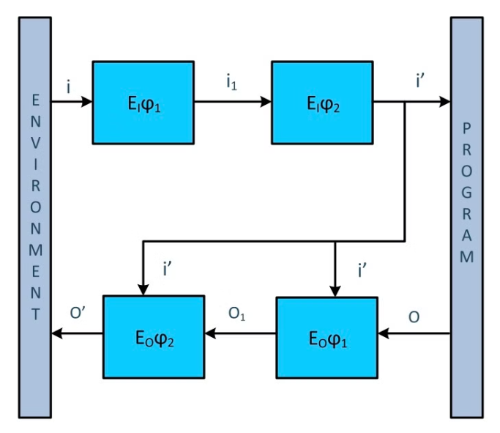
Serial Composition of Enforcers:
Purpose: Combine multiple enforcers, each responsible for a single policy, into a chain (serial composition) to handle several policies incrementally. This technique avoids state space explosion by separating each policy into its own manageable state machine.
Mechanism:
Each enforcer processes the inputs or outputs sequentially, with the output of one enforcer becoming the input of the next.
Serial Composition (Eϕ1 ⇛ Eϕ2): For policies ϕ1 and ϕ2, serial composition ensures that if each individual policy enforcer can satisfy ϕ1 and ϕ2, the composition Eϕ1⇛Eϕ2​​ will enforce the combination ϕ1∧ϕ2​ effectively.

Slide 23
Input and Output Enforcement Functions:
Purpose: Enforce security policies on both inputs and outputs of the CPS to ensure system behavior adheres to specified policies in real-time.
Components:
Input Enforcement Function (EI): Ensures inputs from the environment comply with the defined security policies before they are processed by the CPS.
Output Enforcement Function (EO): Checks and potentially modifies outputs from the CPS before they are returned to the environment, preventing unauthorized actions.

Slide 24
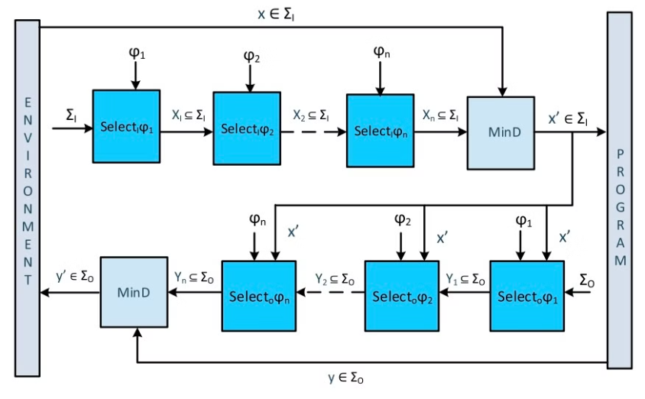
Edit and Select Functions:
Edit Functions:
Used to replace inputs or outputs that violate policies with acceptable alternatives.
editIϕI: For inputs that don’t comply with a policy, this function selects a compliant alternative input that minimizes deviation from the original.
editOϕ: For outputs that violate policy, this function chooses a compliant output with minimal alteration.
Select Functions:
These are used to choose policy-compliant events from a set, enabling precise selection of inputs and outputs that minimally diverge from the intended actions.
SelectIϕI: Given a set of possible inputs XXX, selects a policy-compliant input x′x'x′ close to the original input xxx.
SelectOϕ: Given a set of possible outputs YYY, chooses a compliant output y′y'y′ closest to the original.

Slide 25
Incremental Enforcement Function:
Purpose: Define the overall enforcement behavior that ensures policies are applied incrementally across multiple stages without re-validating the entire system.
Approach:
The incremental enforcement function EEE is built from both the Input (EI) and Output (EO) enforcers to continuously monitor and transform each system event.
Causal Order of Enforcement: This function maintains causality by first processing input events and then applying output enforcement, ensuring that each event is handled in sequence.

Slide 26
Key Advantages of the Algorithms Used
Modularity: Each policy enforcer operates independently, making the system modular and adaptable to new policies.
Real-Time Compliance: Immediate handling of policy violations on both inputs and outputs ensures that the system adheres to security requirements in real-time.
Scalability: By using serial composition and minimizing state transitions, the algorithms handle multiple policies without causing state space explosion, making them scalable for complex CPS environments.
Together, these algorithms offer a robust, scalable approach to enforcing security policies incrementally in CPS, aligning well with real-time needs and providing strong guarantees against both cyber and physical threats.

Slide 27
Conclusion
The project successfully developed a compositional runtime enforcement framework for CPS. This framework allows for the incremental addition of security policies, addressing the state space explosion problem using serial composition.
Serial composition ensures that new security patches can be integrated efficiently without affecting the system's stability or performance.
This approach enables adaptable security for CPS, allowing for the dynamic adaptation of security policies in response to evolving threats and system changes.
References
Incremental Security Enforcement for Cyber-Physical Systems by ABHINANDAN PANDA , ALEX BAIRD, SRINIVAS PINISETTY, AND PARTHA ROOP
Scalable Security Enforcement for Cyber Physical Systems by ALEX BAIRD , ABHINANDAN PANDA , HAMMOND PEARCE , SRINIVAS PINISETTY , AND PARTHA ROOP
Monitoring and Defense of Industrial Cyber-Physical Systems Under Typical Attacks: by Yuchen Jiang , Shimeng Wu , Renjie Ma , Ming Liu , Hao Luo , and Okyay Kaynak

